Slide 1

Department of Ocean Engineering and Naval Architecture
CAD-CAM Laboratory (NA39004)
&
Marine Design Laboratory (NA39006)
Group 18: -
22NA10035 – Pranay Anil Darode
22NA30021 – Praveen Kumar Yadav
22NA10039 - Saksham Mudgal
22NA30026- Sagar Sahu

Slide 2
PURE CAR CARRIER (PCC)
Small PCCs:
DWT: 5,000–10,000
LOA: 100–150 m
Draft: 5–8 m
Cargo Capacity: 10,000–20,000 m³
No. of Tanks: 5–10
Bulkheads: 3–5 transverse, 1 longitudinal
Extra Large PCCs
DWT: 30,000–40,000
LOA: 250–300 m
Draft: 12-14 m
Cargo Capacity: 60,000–80,000 m³
No. of Tanks: 20-25
Bulkheads: 10-12 transverse, 3 longitudinal
Medium PCCs:
DWT: 10,000–20,000
LOA: 150–200 m
Draft: 8-10 m
Cargo Capacity: 20,000–40,000 m³
No. of Tanks: 10–15
Bulkheads: 5–7 transverse, 1–2 longitudinal
Large PCCs
DWT: 20,000–30,000
LOA: 200–250 m
Draft: 10-12 m
Cargo Capacity: 40,000–60,000 m³
No. of Tanks: 15–20
Bulkheads: 7-10 transverse, 2 longitudinal

Slide 3
General Details About Pure Car Carrier Requirements and Prediction
Pure Car Carrier Requirements:
Predicted Dimensions for PCC Carrier:
Ship Type: Post Panamax PCC carrier
Design Capacity: 25000t DWT, 8000 PCTC
Design Speed: 20 Knots
Route: China - Europe (through New Panama Canal) sector
Deadweight Tonnage (DWT): 20,000 -25000 Tonnes
Length Overall (LOA): 200–250 meters: This is within the typical range for Post Paramax PCC Carrier (20,000–30,000 DWT).
Beam (Width): 35 – 40 meters: To accommodate the car capacity and ensure stability, the beam would typically fall in this range.
Draft: 10–12 meters: A draft of 10–12 meters is typical for a PCC Carrier with 20,000 DWT to 25000 DWT when fully loaded.
Car/Truck Carrying Capacity: Cargo Hold Volume: 20,000–25,000 cubic meters. This corresponds with the 20,000 DWT and would align with the number of tanks and bulkheads.
Information About the Data provided:
Deadweight Tonnage (DWT): 25,000 Tonnes, for carrying Cars and Trucks.
Car Capacity : - 8000 PCTC.
Design Speed: 20 knots for fuel-efficient & fast Operation

Slide 4
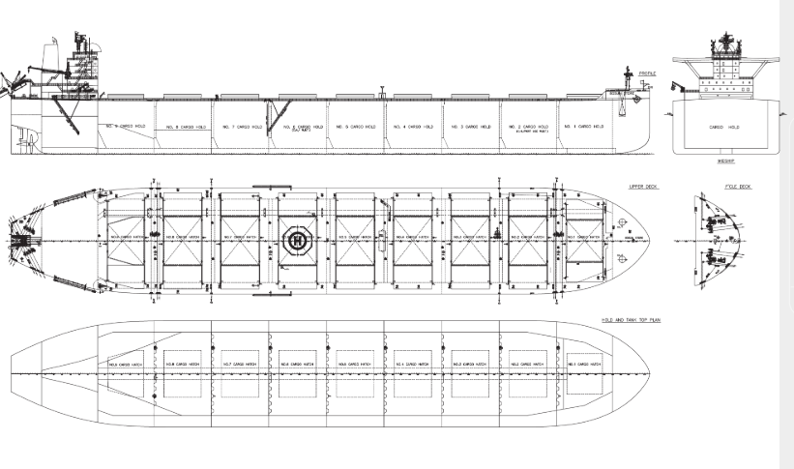
General Arrangement

Slide 5
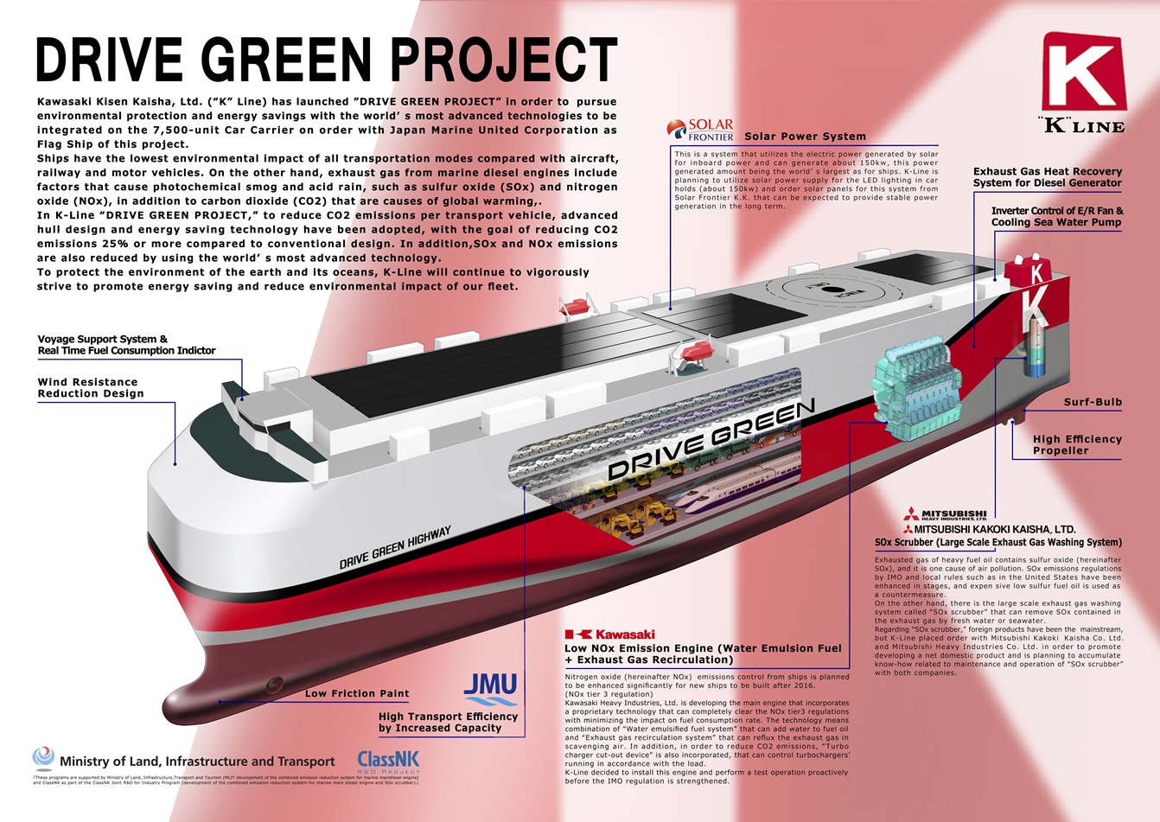

Slide 6
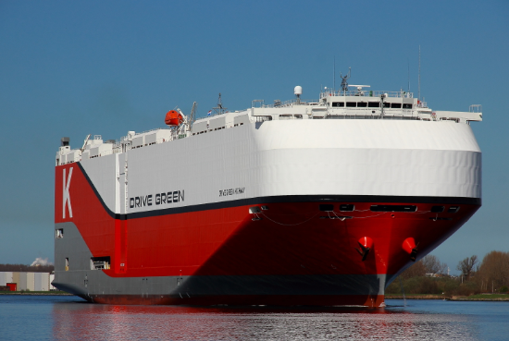
What Are Drive Green Highway-Car Carriers ?
The Drive Green Highway is a class of environmentally friendly car carriers developed to minimize environmental impact while transporting vehicles across the globe. These carriers are part of a new generation of PCCs that focus on sustainability, leveraging innovative technologies and designs.
The Drive Green Highway concept aligns with global efforts like the IMO’s greenhouse gas reduction strategy and corporate sustainability goals for automobile manufacturers. It ensures:
Reduced carbon footprint.
Compliance with international maritime environmental regulations.
Improved efficiency and operational costs for shipping companies

Slide 7
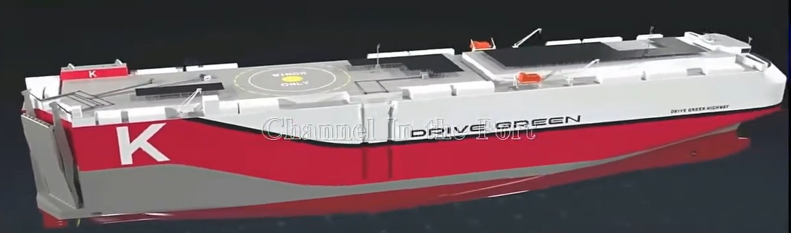
Design And Cargo Tank Configuration
Design
Cargo Tank
It has generally a large PCC dimensions and specifications.
Multi Deck layout with movable decks.
Hull Design consists of efficiency methods like Air Lubrication system.
Fuel-Efficient Engines with Renewable Energy Integration:
Solar panel and energy recovery system.
Fuel Tanks consists of LNG Tanks, Heavy Fuel Oil and Marine Diesel Oil Tanks.
Ballast Tanks consists of a Ballast Water Treatment System(BWTS) to prevent marine ecosystem contamination.
Freshwater Tanks for crew and Operational needs.
Auxiliary tanks like Lubricating Oil tanks and Waste Oil tanks.
Inert Gas systems for LNG tank safety.

Slide 8
Number Of Tanks/ Bulkheads In the Ship
1. Number of Tanks:
Fuel Tanks: For the ship's own propulsion (likely heavy fuel oil or LNG for "green" considerations)
Ballast Tanks: Essential for stability, especially when not fully loaded with vehicles.
Fresh Water Tanks: For crew use and ship operations.
Wastewater Tanks: In compliance with environmental regulations.
No Cargo Tanks: Unlike tankers, there are no dedicated tanks for carrying liquid cargo.
2. Bulkheads Configuration:
Transverse Bulkheads:
2-4 Main Bulkheads: Divide cargo zones and provide structural strength.
Strategic Placement: Support vehicle decks and limit movement in rough seas.
High-Strength Design: Withstands vehicle loads and sea forces.
Longitudinal Bulkheads:
Few or None: Maintains open vehicle deck space.
Partial Bulkheads/Girders: Added for deck and hull support.
Ramp Structures: Internal ramps act as partial longitudinal reinforcements

Slide 9
Construction Features
The "Drive Green Highway" concept in car carrier design emphasizes environmentally friendly and efficient vehicle transport. This translates into specific construction features that differentiate these vessels. Here's a breakdown:
1. Hull Design and Hydrodynamics:
Optimized Hull Form: The hull is designed to minimize water resistance and improve fuel efficiency. This often involves:
Slender hull forms: Reducing the cross-sectional area of the ship at the waterline.
Bulbous bow: A protruding bulb at the bow that reduces wave resistance.
Stern design: Optimized stern shapes to improve water flow to the propeller.
Reduced Friction Coatings: Applying special hull coatings that minimize friction between the hull and water, further improving fuel efficiency.
2. Propulsion and Machinery:
Energy-Efficient Engines: Utilizing modern, fuel-efficient main engines, potentially with features like:
Electronic fuel injection: For precise fuel delivery and combustion.
Exhaust gas recirculation (EGR): To reduce nitrogen oxide (NOx) emissions.

Slide 10
Alternative Fuels: Exploring the use of cleaner fuels like:
Liquefied Natural Gas (LNG): Significantly reduces emissions of SOx, NOx, and particulate matter.
Methanol or Ammonia: Potential future fuels with even lower environmental impact.
Propeller and Rudder Optimization: Designing efficient propellers and rudders to maximize thrust and manoeuvrability while minimizing energy loss.
Waste Heat Recovery Systems: Utilizing waste heat from the engines to generate electricity or for other shipboard uses, improving overall energy efficiency.
3. Structural Design and Materials:
Lightweight Construction: Using high-strength steel or aluminum alloys to reduce the ship's weight, which directly translates to lower fuel consumption.
Optimized Structural Design: Employing advanced structural analysis techniques to minimize the use of materials while maintaining strength and safety.
Bulkhead Configuration: As discussed previously, bulkheads are strategically placed for structural support and stability, with an emphasis on minimizing weight and maximizing open vehicle deck space.

Slide 11
4. Cargo Handling and Stowage:
Efficient Ramp Systems: Internal ramps connecting the vehicle decks are designed for quick and efficient loading and unloading of vehicles.
Optimized Deck Layout: The arrangement of vehicle decks is optimized to maximize cargo capacity and minimize wasted space.
Ventilation Systems: Efficient ventilation systems are crucial to remove exhaust fumes from vehicles during loading/unloading and to maintain air quality within the cargo holds.
5. Environmental Technologies:
Exhaust Gas Cleaning Systems: Installing scrubbers to remove sulphur oxides (SOx) from exhaust gases, or selective catalytic reduction (SCR) systems to reduce NOx emissions.
Ballast Water Treatment Systems: To prevent the spread of invasive species through ballast water discharge.
Energy-Saving Devices: Implementing various energy-saving measures, such as:
Solar panels: To generate auxiliary power.
LED lighting: For reduced energy consumption.
Shore Power Connection: Enabling the ship to connect to shore-based electricity supply while in port, reducing emissions from auxiliary engines.

Slide 12
Shipping Route
Global Trade Routes:
Asia to Europe: Transporting vehicles from manufacturing centers in Japan, South Korea, and China to European markets.
Asia to North America: Shipments to the U.S. and Canada.
Intra-Asia: Transporting vehicles between regional markets in Asia.
Post Panamax Pure Car Carrier (PCC) like the Drive Green Highway typically operates on a global route connecting Asia, Europe, and the Americas to transport automobiles and rolling cargo. Starting in Japan, with stops at major ports like Yokohama, Nagoya, and Kobe, the ship picks up vehicles and heavy machinery before heading to Busan in South Korea and Shanghai in China. After refueling in Singapore, it transits the Suez Canal to reach Europe, where key ports like Bremerhaven (Germany), Zeebrugge (Belgium), and Southampton (UK) serve as hubs for unloading and reloading vehicles

Slide 13
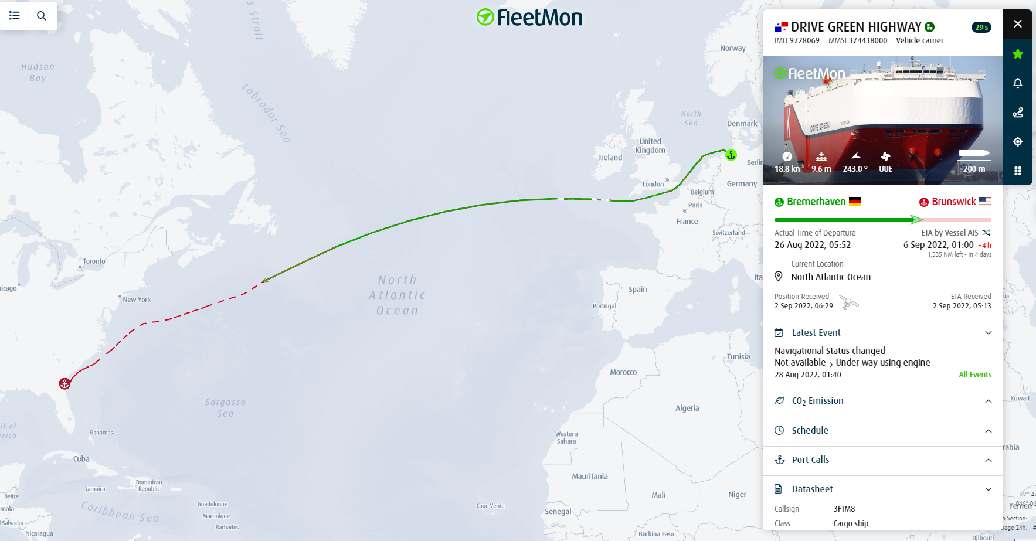
The journey continues across the Atlantic to the US East Coast, with stops at Baltimore or Newark, and then to Houston in the Gulf Coast. From there, it transits the Panama Canal to reach Mexico (Lazaro Cardenas) and the US West Coast (Long Beach or Los Angeles). Finally, the ship crosses the Pacific Ocean, returning to Japan to complete the cycle. This route emphasizes fuel efficiency, compliance with eco-zones, and flexibility to adjust for weather conditions, ensuring the smooth delivery of cargo worldwide

Slide 14
PRE-LOADING PREPARATION
RAMP DEPLOYMENT:
Deploy wide, heavy-duty stern ramps connecting the ship to the terminal
VENTILATION:
Activate deck ventilation systems to prevent exhaust buildup during vehicle entry.
CARGO PLANNING:
Heavier vehicles like trucks and machinery are allocated to lower decks for stability.
Lighter vehicles such as cars are placed on upper decks.
Electric vehicles (EVs) are parked near onboard charging stations

Slide 15
LOADING OPERATIONS
Roll-On/Roll-Off Operations:
Vehicles are driven onboard by port drivers or crew.
Guidance systems (lane markings, mirrors, personnel) assist drivers in narrow spaces.
Securing Cargo:
Wheel chocks to prevent rolling.
Lashing straps attached to designated tie-down point.
Cargo Monitoring:
Real-time monitoring systems ensure proper weight distribution and stability.
Environmental and Safety Checks:
Maintain clear emergency exits.
Conduct periodic checks for fire suppression readiness during loading.

Slide 16
UNLOADING OPERATIONS
Ramp Alignment:
Ensure internal ramps and lifts are adjusted for vehicle flow between decks.
Roll-Off Operations:
Vehicles are driven off the ship in reverse loading order.
Start with uppermost decks and move to lower decks.
Lighter vehicles are unloaded first, followed by heavier vehicle.
Deck Inspections:
Ensure all vehicles are cleared from each deck.
Ballast Adjustments:
Rebalance ballast tanks to maintain vessel stability for the return voyage.

Slide 17
ADVANTAGES AND DISADVANTAGES
Advantages
Disadvantages
Environmental Benefits: LNG propulsion and energy-efficient systems reduce emissions.
Optimized Cargo Handling: Advanced stowage planning and wide ramps enhance efficiency.
Lower Costs: Fuel-efficient designs cut operational expenses.
Safety: Robust ventilation and fire suppression systems ensure safety.
Port Accessibility: Compatible with varied terminal setups.
High Costs: Expensive to build and maintain.
LNG Limitations: Limited global bunkering infrastructure.
Cargo Limits: Fixed deck heights restrict oversized cargo.
Complex Maintenance: Advanced systems require specialized skills.
Methane Emissions: LNG emits methane, a potent greenhouse gas.

Slide 18
How to Mitigate the Disadvantages of Green Drive Highway
High Initial Costs: Use modular retrofitting, green financing, and government subsidies.
Technological Limitations: Employ hybrid propulsion systems and invest in battery and biofuel research.
Energy Storage Issues: Incorporate advanced batteries, hydrogen storage, and hybrid energy systems.
Maintenance Complexity: Develop specialized facilities, train crews, and schedule predictive maintenance.
Environmental Impact: Use recycled materials, low-carbon manufacturing, and offset emissions with reforestation.
Innovative Technologies Steering the Future of Green Highways
Hybrid Propulsion: Combine electric engines with biofuels or LNG for cleaner energy.
Solar-Powered Sails: Install photovoltaic panels and AI-controlled sails for renewable power.
Hydrogen Fuel Cells: Use hydrogen for clean energy with water as a byproduct.
Air Lubrication: Reduce hull friction with microbubble technology to enhance efficiency.
IoT and AI Systems: Monitor performance, optimize routes, and improve energy efficiency.
Rotor Sails: Utilize wind energy through advanced sails or kites for reduced fuel consumption.
Carbon Capture: Capture and store CO₂ emissions onboard to lower environmental impact.
Advanced Hull Materials: Use lightweight composites or graphene to reduce drag and improve durability.

Slide 19
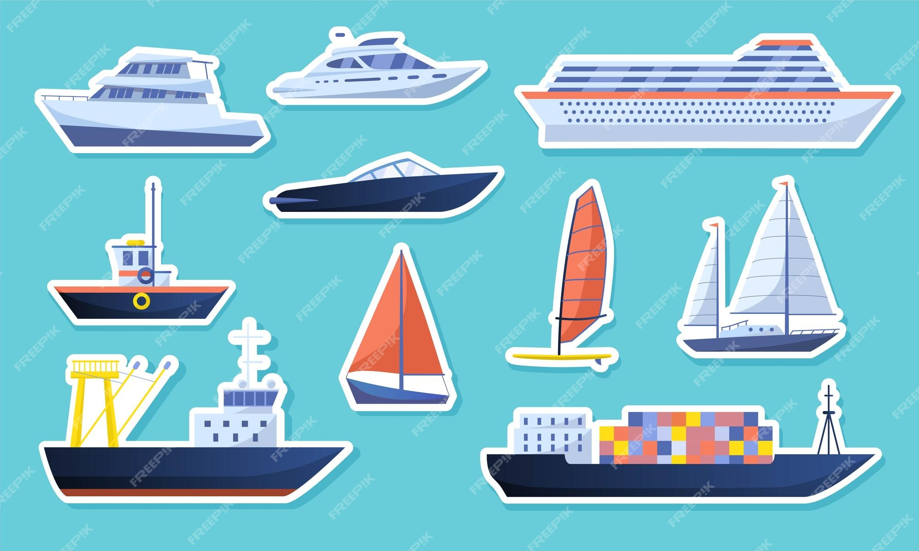
Thank You

